Slide 1
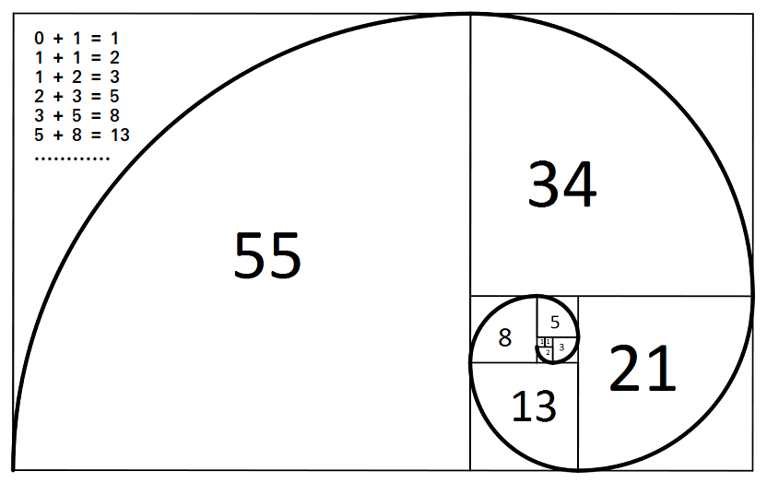

Slide 2
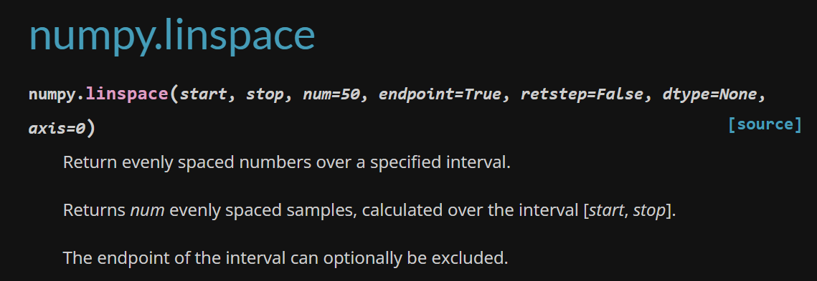

Slide 3
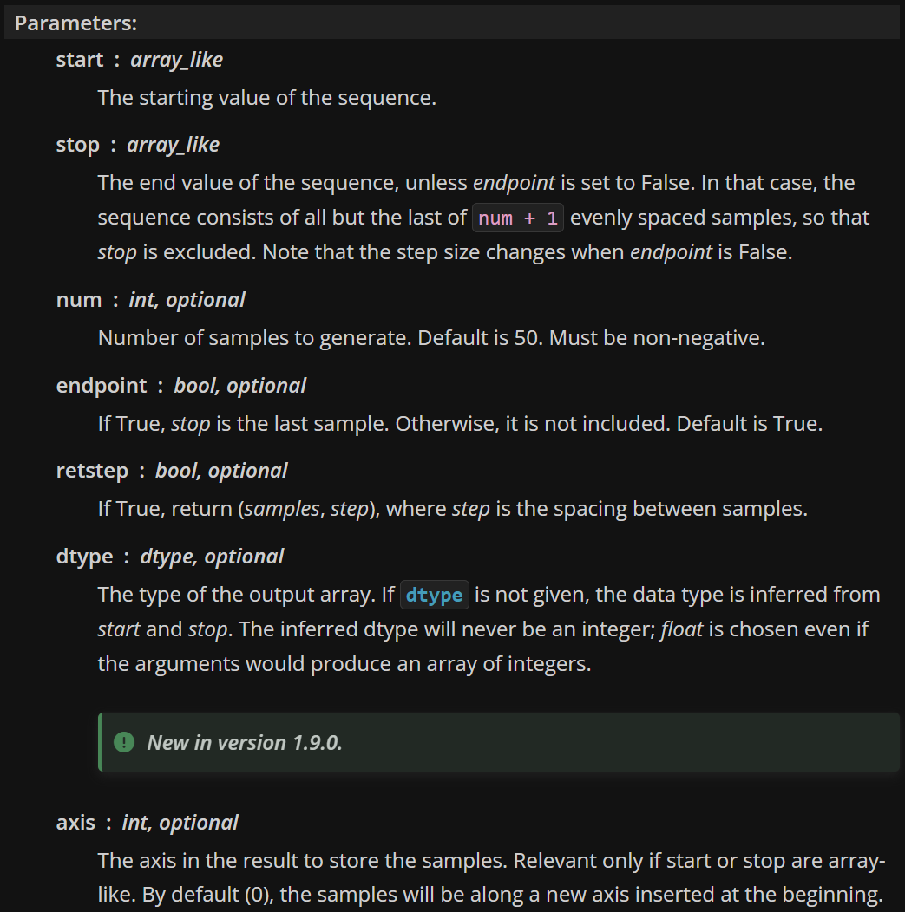

Slide 4
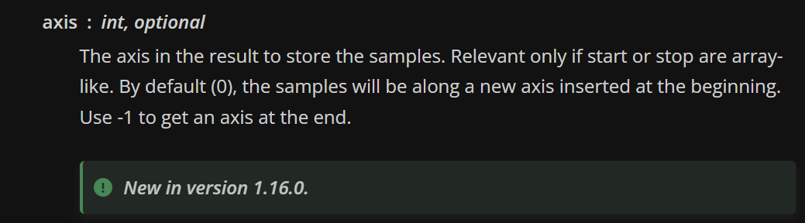

Slide 5
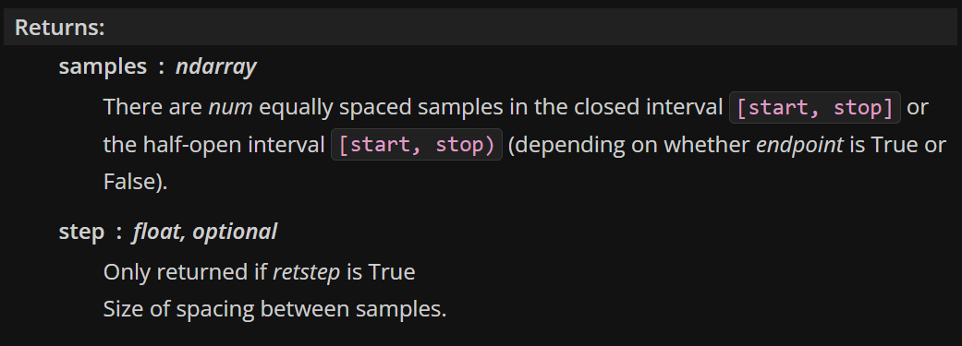

Slide 6
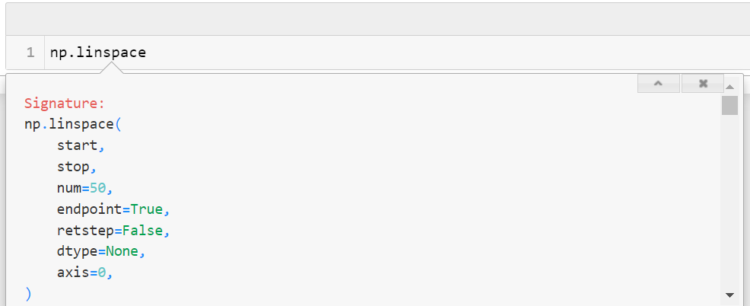

Slide 7
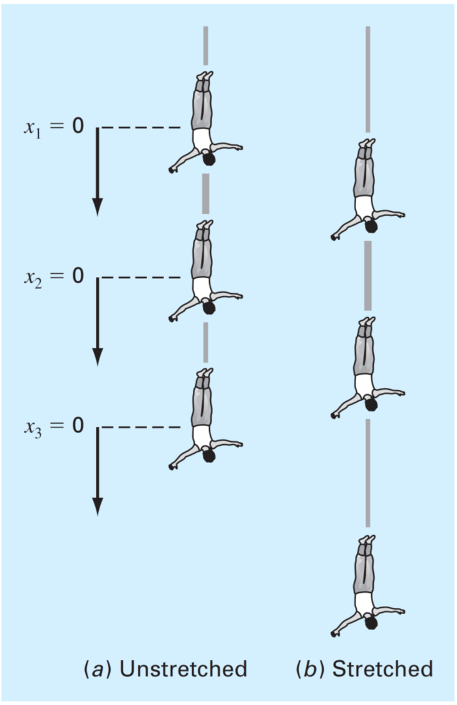

Slide 8
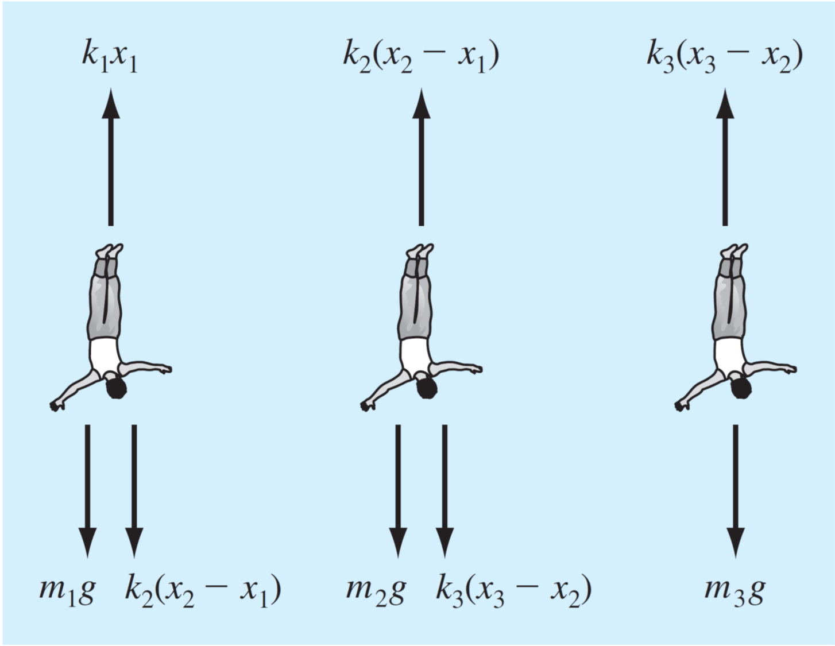

Slide 9
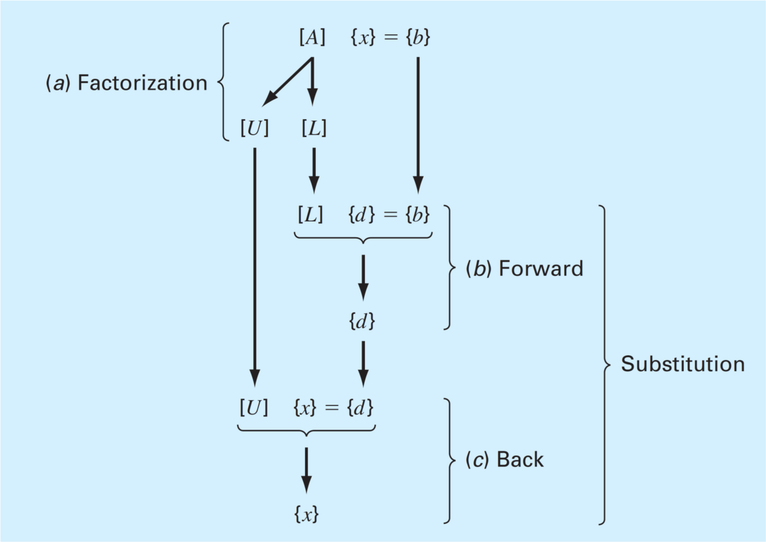
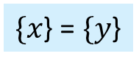
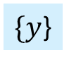
$\{x\text{\}}\text{ = }\{y$}
$\{y$}

Slide 10
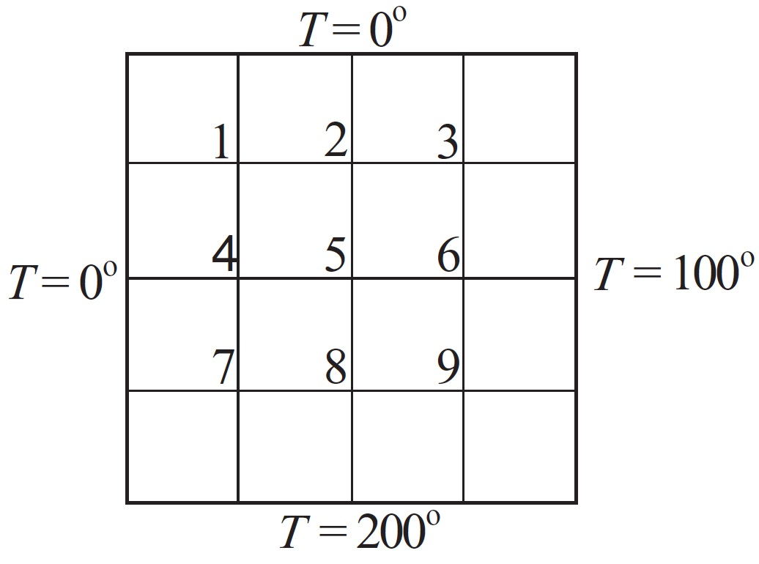
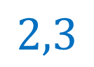
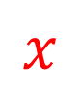
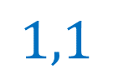
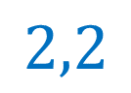
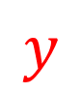
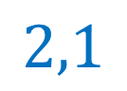
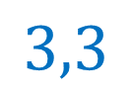
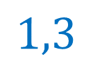
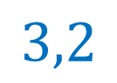
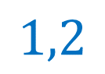
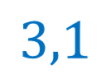
$$x$$
$$1,1$$
$$1,2$$
$$1,3$$
$$y$$
$$2,1$$
$$2,2$$
$$2,3$$
$$3,1$$
$$3,2$$
$$3,3$$

Slide 11
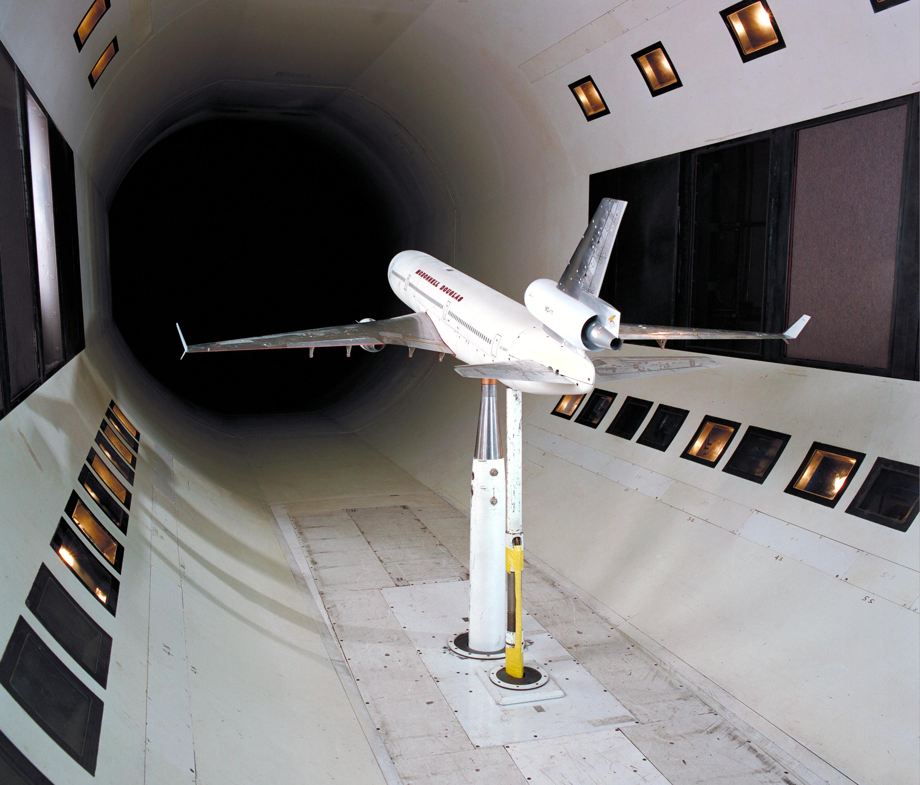
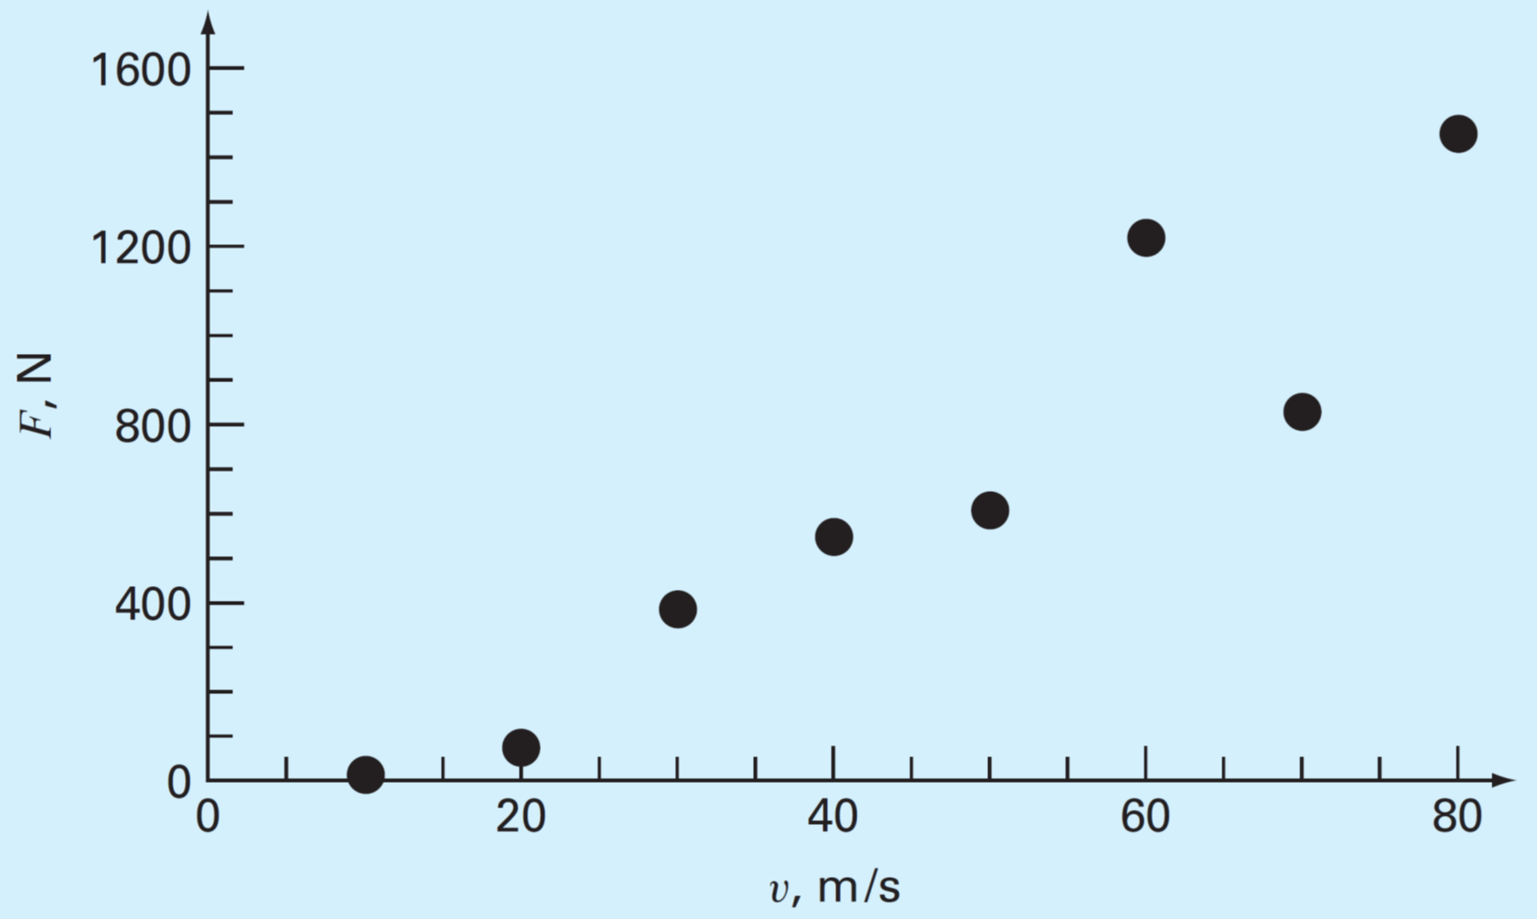

Slide 12
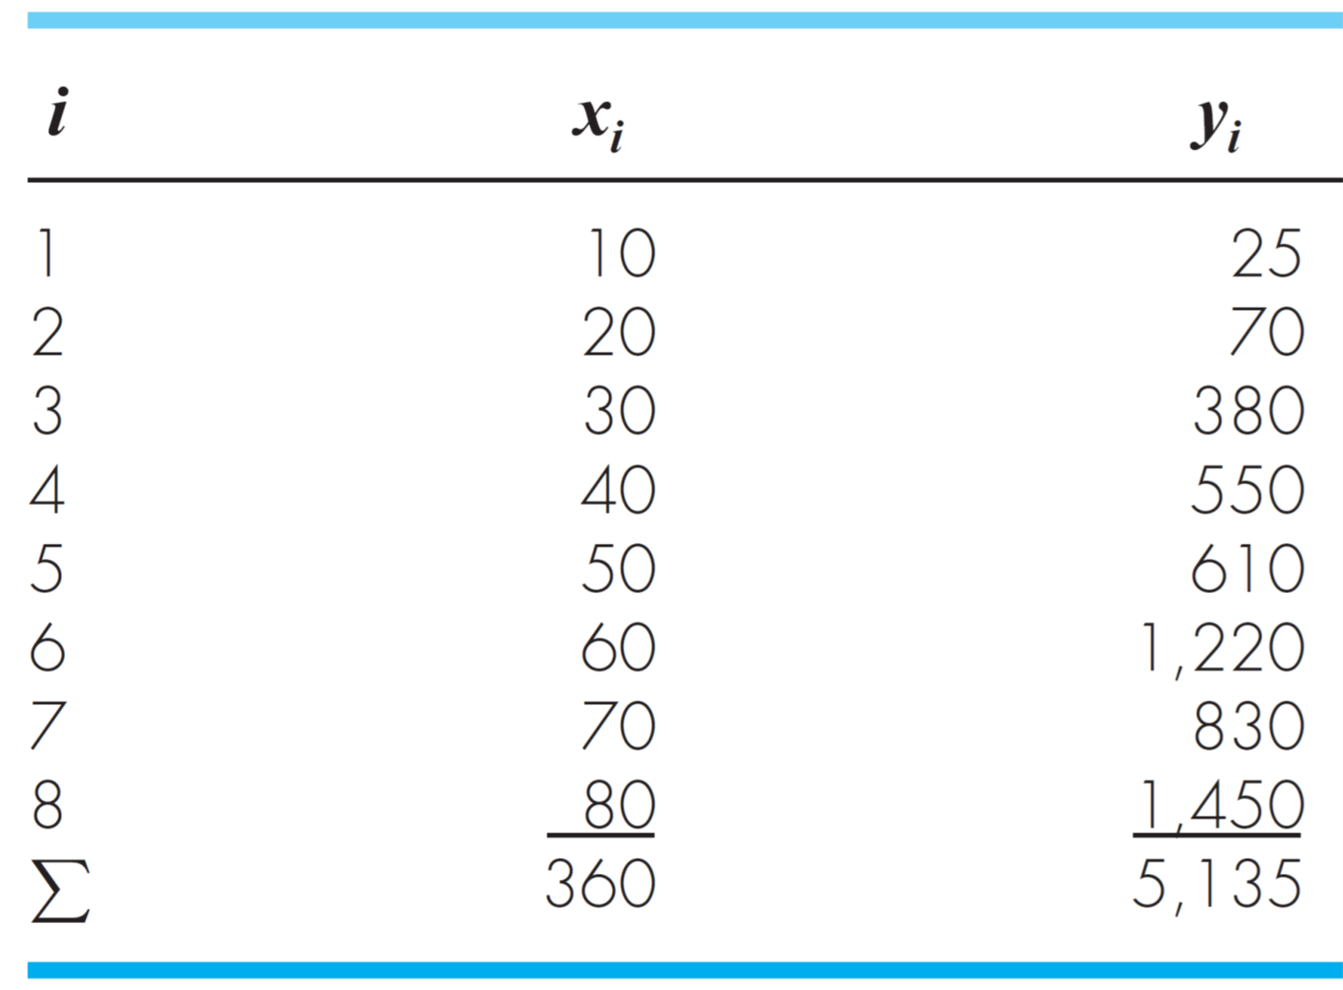

Slide 13
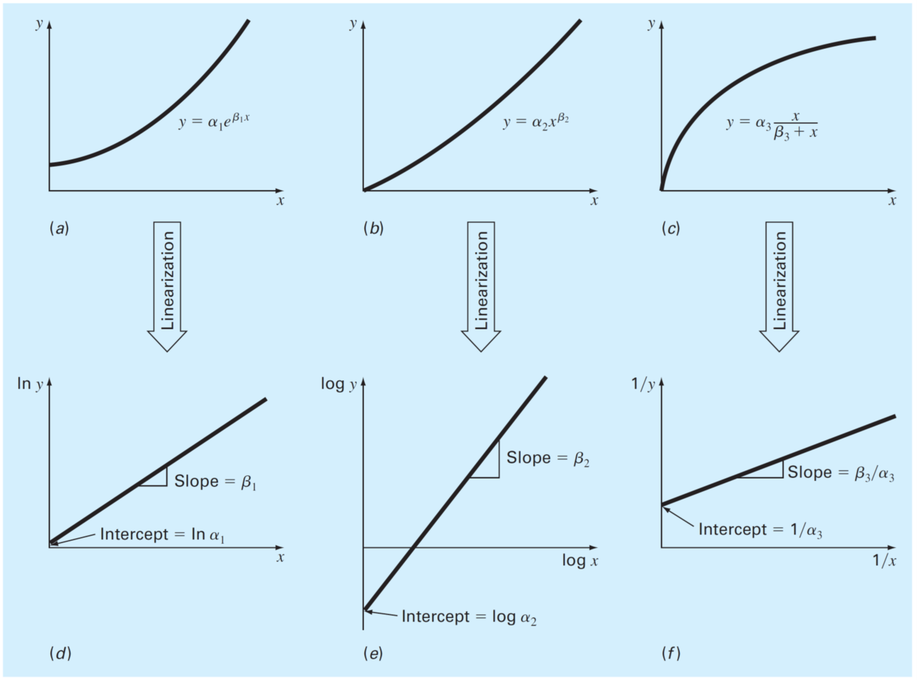

Slide 14
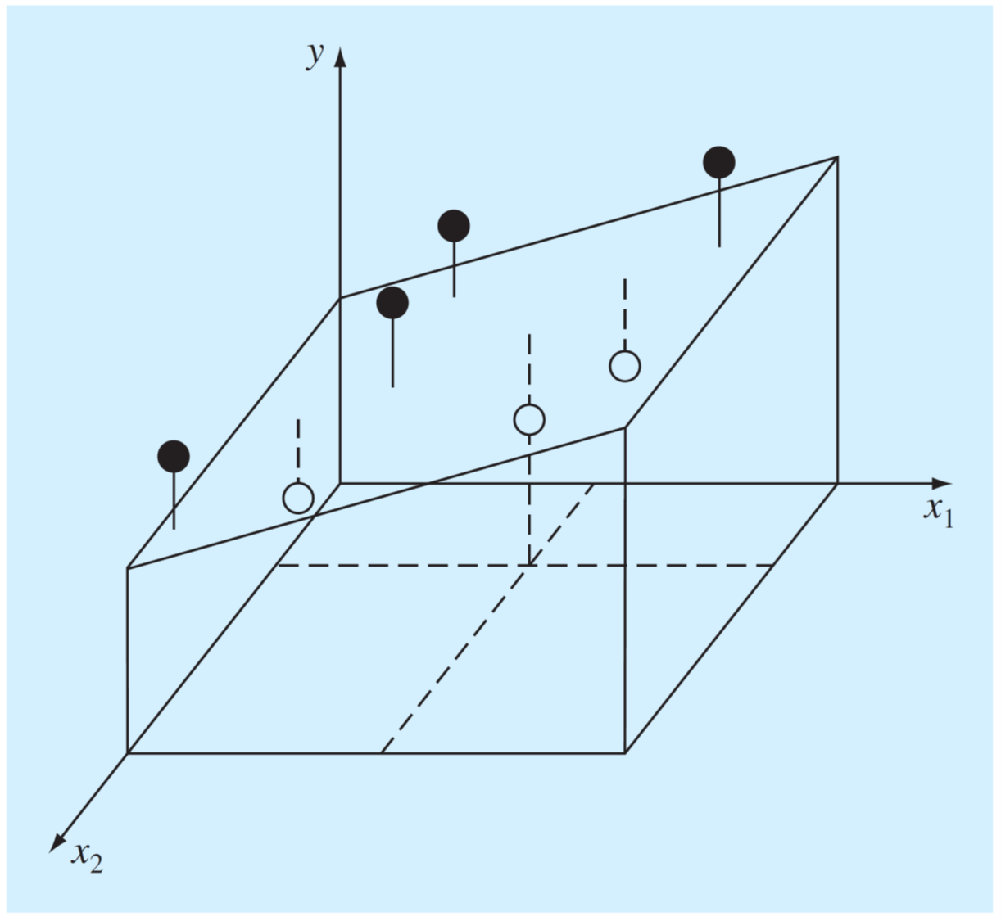

Slide 15
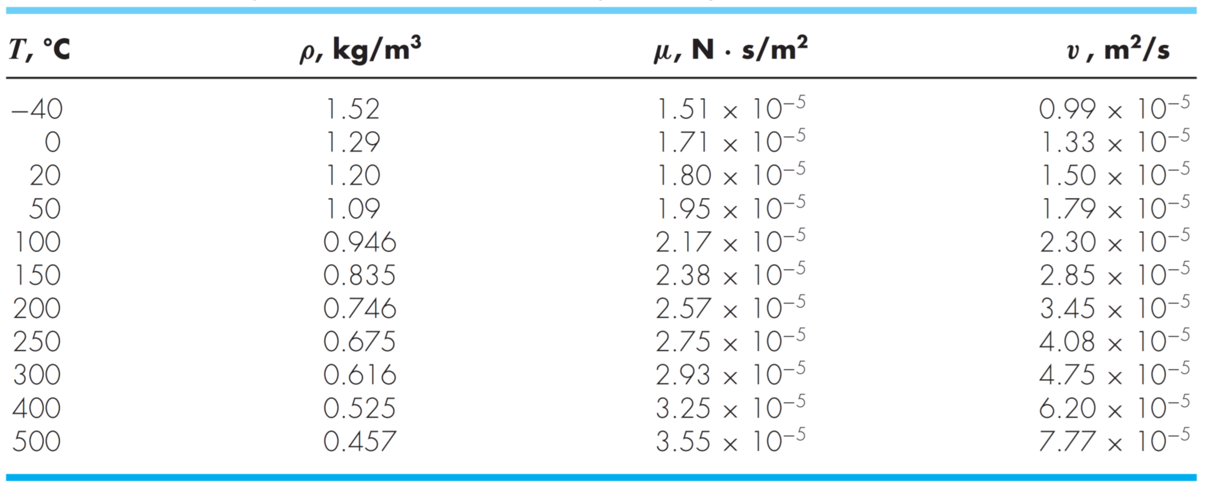

Slide 16
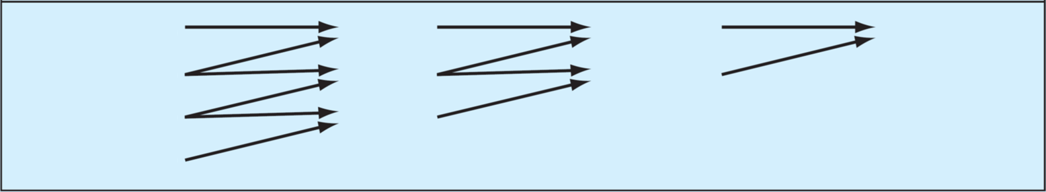
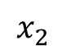
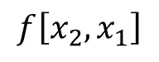
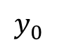
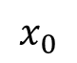
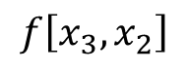
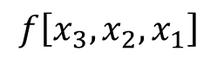
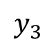
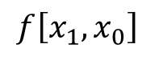
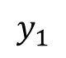
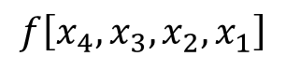
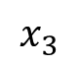
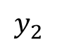
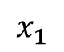
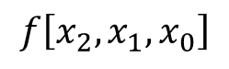
$$x_{0}$$
$$y_{0}$$
$$f_{ }\left[x_{1},x_{0}\right]$$
$$f_{ }\left[x_{2},x_{1},x_{0}\right]$$
$$f_{ }\left[x_{4},x_{3},x_{2},x_{1}\right]$$
$$x_{1}$$
$$y_{1}$$
$$f_{ }\left[x_{2},x_{1}\right]$$
$$f_{ }\left[x_{3},x_{2},x_{1}\right]$$
$$x_{2}$$
$$y_{2}$$
$$f_{ }\left[x_{3},x_{2}\right]$$
$$x_{3}$$
$$y_{3}$$

Slide 17
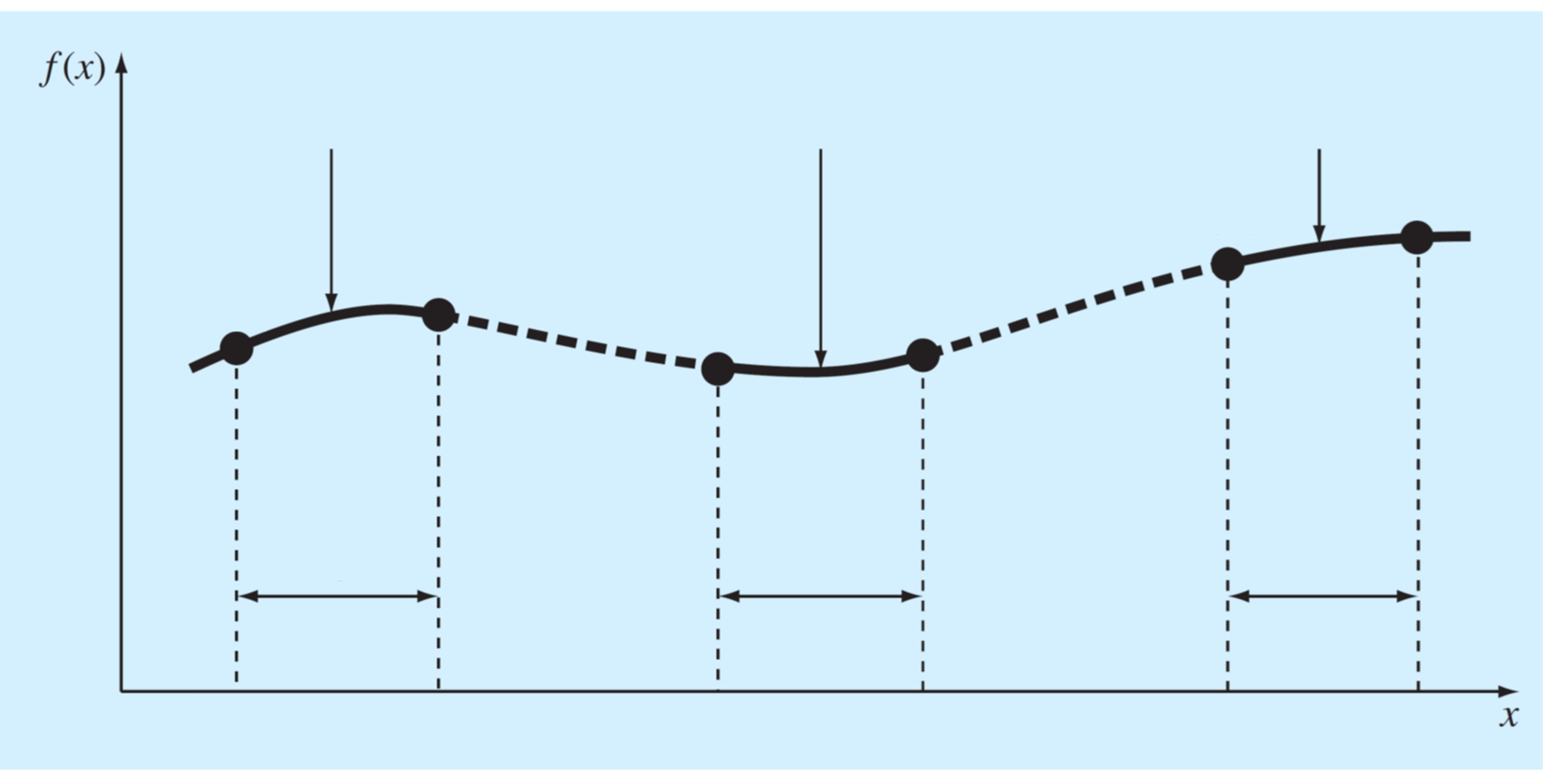
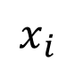
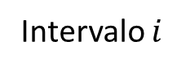
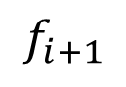
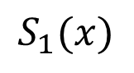
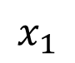













$$S_{1}(x)$$
$$S_{i}(x)$$
$$S_{n}(x)$$
$$f_{n−1}$$
$$f_{n}$$
$$f_{1}$$
$$f_{0}$$
$$f_{i}$$
$$f_{i+1}$$
Intervalo $1$
Intervalo $i$
Intervalo $n$
$$x_{0}$$
$$x_{1}$$
$$x_{i}$$
$$x_{i+1}$$
$$x_{n−1}$$
$$x_{n}$$

Slide 18


Slide 19

$S$ (M) | $v$ (M/s)
0.01 | $$\text{6.079}×{10}^{−11}$$
0.05 | $$\text{7.}591×{10}^{−9}$$
0.1 | $$6.062×{10}^{−8}$$
0.5 | $$5.785×{10}^{−6}$$
1 | $$1.736×{10}^{−5}$$
5 | $$2.423×{10}^{−5}$$
10 | $$2.428×{10}^{−5}$$
50 | $$2.430×{10}^{−5}$$
100 | $$2.433×{10}^{−5}$$
$$x$$ | −0.04 | 0.93 | 1.95 | 2.90 | 3.83 | 5.00 | 5.98 | 7.05 | 8.21 | 9.08 | 10.09
$$y$$ | 3.28 | 10.52 | 34.21 | 76.58 | 122.38 | 207.02 | 303.77 | 412.30 | 566.72 | 695.33 | 889.31

Slide 20





$$P_{1}$$
$$P_{2}$$
$$ΔP=P_{2}−P_{1}<0$$
$$V$$
$$D$$
$$L$$

Slide 21






$$f(b)$$
$$c$$
$$a$$
$$b$$
$$f(a)$$

Slide 22















$$f(x)$$
$$x$$
$$x_{0}$$
$$a$$
$$m_{1}$$
$$b$$
1era iteración
$$m_{1}$$
$$m_{2}$$
$$b$$
2da iteración
$$m_{1}$$
$$m_{3}$$
$$m_{2}$$
3ra iteración
$$m_{3}$$
$$m_{2}$$
4ta iteración

Slide 23







$$f(x)$$
$$f′(x_{k})$$
$$f(x_{k})$$
$$x_{k+1}$$
$$x_{k}$$
$$x$$

Slide 24

Z (m) | 0 | 2.3 | 4.9 | 9.1 | 13.7 | 18.3 | 22.9 | 27.2 | 30.0
T (°C) | 22.8 | 22.8 | 22.8 | 20.6 | 13.9 | 11.7 | 11.1 | 11.1 | 11.1
U (m/s) | 0.5 | 2 | 10 | 0.5 | 2 | 10 | 0.5 | 2 | 10
H (m) | 0.15 | 0.15 | 0.15 | 0.3 | 0.3 | 0.3 | 0.5 | 0.5 | 0.5
KL (m/d) | 0.48 | 3.9 | 57 | 0.85 | 5 | 77 | 0.8 | 9 | 92

Slide 25


Slide 26
Kl_predict(2, 0.15)
Kli=3.9

Slide 27


Slide 28














$$f\left(x\right)$$
$$f\left(x\right)$$
$$f\left(x\right)$$
$$a$$
$$b$$
$$x$$
$$a$$
$$b$$
$$x$$
$$a$$
$$b$$
$$x$$

Slide 29





$$h_{i}$$
$${f(x}_{i})$$
$$x_{i}$$
$$x_{i+1}$$
$$x$$

Slide 30



$$f\left(x\right)$$
$$h_{i}$$
$$x_{i}$$
$$x_{i+1}$$
$$x$$

Slide 31





$$h_{i}$$
$$f\left(x\right)$$
$$x_{0}$$
$$x_{1}$$
$$x_{2}$$
$$x_{3}$$
$$x_{4}$$
$$x$$

Slide 32





$$f\left(x\right)$$
$$f\left(x\right)$$
$$x$$
$$x$$

Slide 33

Orden
Pesos
Puntos de evaluación
Error

Slide 34


Bomba
$$H_{0} =65 m$$
$$D=120 mm$$

Slide 35






$$H$$
Curva de rendimiento de la bomba
$$H_{bba}\left(Q\right)$$
$$H_{sys}\left(Q\right)$$
Punto de operación
$$H_{op}$$
Curva de demanda del sistema
$$Q_{op}$$
$$Q$$

Slide 36

Nombre | Ecuación | Campo de estudio | Parámetro descrito | Variable dependiente | Constante de proporcionalidad
Ley de Fourier | $$q=−k\frac{dT}{dx}$$ | Conducción de calor | Flujo de calor | Temperatura | Conductividad térmica
Ley de Fick | $$J_{m}=−D\frac{dc}{dx}$$ | Difusión de masa | Flujo másico | Concentración | Difusividad
Ley de Ohm | $$J_{e}=−σ\frac{dV}{dx}$$ | Electricidad | Flujo de corriente eléctrica | Voltaje | Conductividad eléctrica
Ley de viscosidad de Newton | $$τ=μ\frac{du}{dx}$$ | Mecánica de Fluidos | Tensión de corte | Velocidad | Viscosidad dinámica
Ley de Hook | $$σ=ε\frac{ΔL}{L}$$ | Elasticidad | Tensión mecánica | Deformación | Módulo de Young

Slide 37


Slide 38


Slide 39



Slide 40



























$$\frac{f\left(x_{i}\right)−f(x_{i−1})}{x_{i}−x_{i−1}}$$
$$f\left(x\right)$$
$$f\left(x\right)$$
$$f\left(x\right)$$
$$f′\left(x_{i}\right)$$
$$f′\left(x_{i}\right)$$
$$\frac{f\left(x_{i+1}\right)−f(x_{i−1})}{x_{i+1}−x_{i−1}}$$
$$f′\left(x_{i}\right)$$
$$\frac{f\left(x_{i+1}\right)−f(x_{i})}{x_{i+1}−x_{i}}$$
$$h$$
$$h$$
$$h$$
$$h$$
$$h$$
$$h$$
$$x$$
$$x$$
$$x$$
$$x_{i−1}$$
$$x_{i}$$
$$x_{i+1}$$
$$x_{i−1}$$
$$x_{i}$$
$$x_{i+1}$$
$$x_{i−1}$$
$$x_{i}$$
$$x_{i+1}$$

Slide 41




Componente
especular
Luz incidente
Gases atmosféricos
$$t_{atm}$$
$$θ_{sun}$$
$$θ_{sun}$$
Componente difusa

Slide 42




$$Q$$
$$Q_{1}$$
$$Q$$
$$Q_{2}$$

Slide 43



$$l$$
$$Θ$$
$$m$$

Slide 44












Pendiente
$$k_{2}=F\left(t_{i+1},y_{i}+k_{1}h\right)$$
Pendiente
$$\frac{F\left(t_{i},y_{i}\right)+F\left(t_{i+1},y_{i}+k_{1}h\right)}{2}$$
Pendiente
$k_{1}=F\left(t_{i},y_{i}\right)$
$$y_{i}+k_{1}h$$
$$y_{i}+\frac{1}{2} \left(k_{1}+k_{2}\right)h$$
$$t_{i}$$
$$t_{i+1}$$
$$t$$
$$t_{i}$$
$$t_{i+1}$$
$$t$$
Predictor
Corrector

Slide 45










Pendiente
$k_{2}=F\left(t_{i+1/2},y_{i}+k_{1}h/2\right)$
Pendiente
$k_{2}=F\left(t_{i+1/2},y_{i}+k_{1}h/2\right)$
$$y_{i}+k_{2}h$$
Pendiente
$k_{1}=F\left(t_{i},y_{i}\right)$
$$t_{i}$$
$$t_{i+1/2}$$
$$t$$
$$t_{i}$$
$$t_{i+1}$$
$$t$$
Predictor
Corrector

Slide 46






$$y$$
$$h$$
$$t_{i}$$
$$t_{i+1}$$
$$t$$

Slide 47

Predictor
Corrector

Slide 48


Slide 49




$t$, (min) | 0 | 5 | 10 | 15 | 20 | 25
$T$ (°C) | 80 | 44.5 | 30.0 | 24.1 | 21.7 | 20.7

Slide 50








radiación
$$T_{a}$$
$${σ′(T}_{∞}^{4}−T^{4})$$
$$T_{b}$$
$$dx$$
convección
$$h^{′}\left(T_{∞}−T\right)$$
$$x$$
$$0$$
$$L$$

Slide 51


Slide 52

radiación
$${\left.\frac{dT}{dx}\right|}_{x=L}=h\left[T_{∞}−T\left(L\right)\right]$$
$$T_{a}$$
$${σ′(T}_{∞}^{4}−T^{4})$$
$$dx$$
convección
$$h^{′}\left(T_{∞}−T\right)$$
$$x$$
$$0$$
$$L$$

Slide 53
$$T_{a}$$
$$T_{b}$$
$$dx$$
convección
$$h^{′}\left(T_{∞}−T\right)$$
$$x$$
$$0$$
$$L$$

Slide 54

$${\left.\frac{dT}{dx}\right|}_{x=L}=h\left[T_{∞}−T\left(L\right)\right]$$
$$T_{a}$$
$$dx$$
convección
$$h^{′}\left(T_{∞}−T\right)$$
$$x$$
$$0$$
$$L$$

Slide 55


Slide 56


Slide 57




$$m,n$$
$$0,n$$
$$m,0$$

Slide 58






$${\left.\frac{dT}{dy}\right|}_{y=H}=h\left[T_{∞}−T\left(x,H\right)\right]$$
$$L$$
$$T\left(0, y\right)=T_{a}$$
$$T\left(L, y\right)=T_{b}$$
$$H$$
$${\left.−\frac{dT}{dy}\right|}_{y=0}=q_{0}$$

Slide 59













$${\left.\frac{dT}{dy}\right|}_{y=H}=h\left[T_{∞}−T\left(x,H\right)\right]$$
$$0,2$$
$$1,2$$
$$2,2$$
$$0,1$$
$$1,1$$
$$2,1$$
$$T\left(0, y\right)=T_{a}$$
$$T\left(L, y\right)=T_{b}$$
$$0,0$$
$$1,0$$
$$2,0$$
$$−{\left.\frac{dT}{dy}\right|}_{y=0}=q_{0}$$

Slide 60

$$T_{0,0}^{∗}=T_{a}$$

Slide 61


$$1,1$$
$$T_{1,0}^{∗}=T_{1,1}+Δyq_{0}$$

Slide 62


$$2,1$$
$$T_{2,0}^{∗}=T_{2,1}+Δyq_{0}$$

Slide 63

$$T_{m,0}^{∗}=T_{b}$$

Slide 64

$$T_{1,0}^{∗}=T_{a}$$

Slide 65





$$1,2$$
$$0,1$$
$$2,1$$
$$1,0$$
$$T_{1,1}^{∗}=\frac{1}{2Δx^{2}+2Δy^{2}}\left[2Δy^{2}\left(T_{2,1}+T_{0,1}^{∗}\right)+2Δx^{2}\left(T_{1,2}+T_{1,0}^{∗}\right)\right]$$

Slide 66





$$2,2$$
$$1,1$$
$$3,1$$
$$2,0$$
$$T_{2,1}^{∗}=\frac{1}{2Δx^{2}+2Δy^{2}}\left[2Δy^{2}\left(T_{3,1}+T_{1,1}^{∗}\right)+2Δx^{2}\left(T_{2,2}+T_{2,0}^{∗}\right)\right]$$

Slide 67

$$T_{m,1}^{∗}=T_{b}$$

Slide 68

$$T_{0,n}^{∗}=T_{a}$$

Slide 69


$$T_{1,n}^{∗}=\frac{1}{1+hΔy}\left(T_{1,n−1}^{∗}+ΔyhT_{∞}\right)$$
$$1,n−1$$

Slide 70


$$T_{2,n}^{∗}=\frac{1}{1+hΔy}\left(T_{2,n−1}^{∗}+ΔyhT_{∞}\right)$$
$$2,n−1$$

Slide 71

$$T_{m,n}^{∗}=T_{b}$$

Slide 72







$$L$$
$$q$$
$$x$$
$$L$$
$$l$$
$$y$$
$$z$$

Slide 73













Vista frontal de la barra
Vista lateral de la barra
Evolución de la temperatura radial de la barra
$$r$$
Aire a temperatura $T_{∞}$
convección
$$0$$
$$1$$
$$⋯$$
$$i$$
$$⋯$$
$$n$$
$$h^{′}\left(T\left(R\right)−T_{∞}\right)$$
$$2R$$
$$R$$

Slide 74





convección
$$h\left(T_{r=R} −T_{∞}\right)$$
$$r$$
$$0$$
$$1$$
$$⋯$$
$$i$$
$$⋯$$
$$n$$
$$R$$

Slide 75










Ecuación gobernante, $r∈\left[R,∞\right)$
$$−{k_{w}\left.​\frac{∂T_{w}}{∂r}\right|}_{r=R}=q_{R}$$
$$\frac{∂^{2}T_{w}}{∂r^{2}}+\frac{2}{r}\frac{∂T_{w}}{∂r}=0$$
Partícula de oro
$$q_{R}$$
$$r$$
Condiciones de borde
$$−{k_{w}\left.​\frac{∂T_{w}}{∂r}\right|}_{r=R}=q_{R}; T_{w}\left(r=R\right)=100° C$$
$$−{k_{w}\left.​\frac{∂T_{w}}{∂r}\right|}_{r=R_{∞}}≈0$$
$$R$$
$$R_{∞}$$
$$T_{w}\left(r=R\right)=100° C$$
Agua

